Slide 1

Smart Campus
Utilizing AI assistants for enhanced educational environments. Introducing a seamless blend of technology and education.
TEAM MEMBERS:-
RAMAN-2401420021
RAYYAN-2401420046
MANJEET-2401420045
RISHAB-2401420054

Slide 2

Introduction to Smart Campus
Presentation Focus
Key Benefits
Exploring Smart Campus concept
Optimized resource management
AI assistants improving services
Enhanced learning environments
Boosting efficiency and engagement
Improved communication

Slide 3
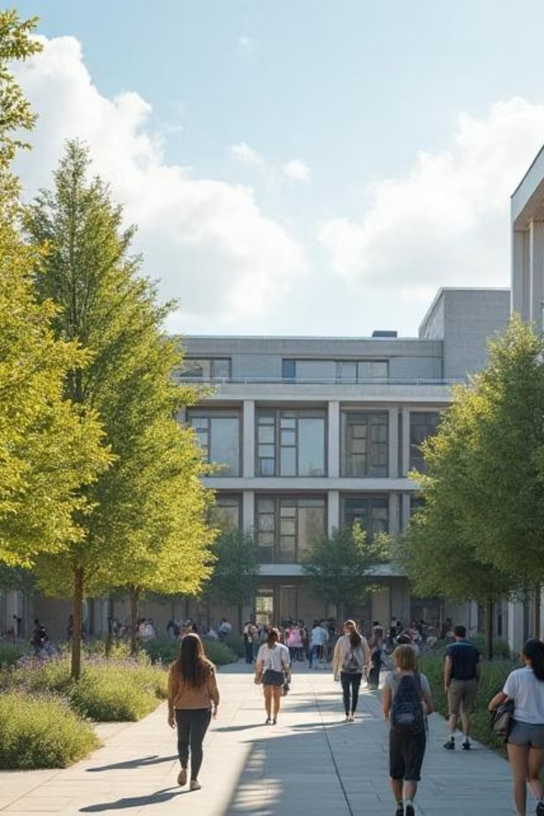
Overview
1
Definition & Scope
What constitutes a Smart Campus
2
AI Importance
Role of AI assistants
3
Current Trends
Emerging technologies
4
Applications
Student services and safety

Slide 4

Definition of Smart Campus
Technology Integration
Operational Efficiency
Enhanced Learning
Interactive and responsive environment
IoT devices and AI-powered solutions
Resource management and automation

Slide 5






Importance of AI Assistants
Streamline communication
Personalize learning
Support administration
Improve engagement
Optimize resource use
Enhance decision-making

Slide 6
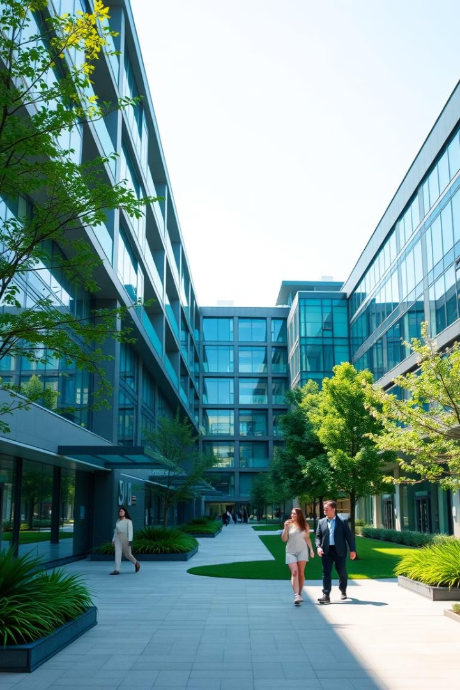
Current Trends in Smart Campuses
Advanced AI Adoption
Personalized learning tech
IoT Connectivity
Smart devices network
Data Analytics
Informed decision-making
Sustainability Focus
Energy-efficient systems

Slide 7

Applications: Student Services
Instant Inquiry Responses
Enrollment Assistance
Course schedules, facilities info
Streamlined registration processes
Personalized Recommendations
Resources and activities tailored

Slide 8





Applications: Administrative Efficiency
Automation
1
Error Reduction
Scheduling and data entry
2
Minimize manual mistakes
Staff Empowerment
4
Data-Driven
Focus on strategic tasks
3
Optimize resources and decisions

Slide 9
PROBLEM STATEMENT
Traditional campus environments face challenges including inefficient student service response times, administrative overload caused by manual data management, and limited personalized support for learners.
Communication gaps between students, faculty, and staff often lead to delayed information dissemination and reduced engagement.
Resource management inefficiencies increase operational costs and hinder the delivery of a high-quality educational experience.
Smart Campus solutions leveraging AI assistants aim to address these issues by automating routine tasks, enhancing real-time interaction, and optimizing campus resources for improved efficiency and satisfaction.

Slide 10
Key Features of the Smart Campus Project
AI-Powered Assistants to streamline communication, personalize learning, and support administration.
IoT Device Integration enabling real-time monitoring and management of campus facilities.
Automated Administrative Processes to reduce errors and improve operational efficiency.
Data Analytics for informed decision-making and resource optimization.
Enhanced Student Services such as instant inquiry responses and personalized recommendations.
Sustainability Focus through energy-efficient systems and smart resource management.

Slide 11

Conclusion & Future Work
Smart Campus boosts education quality
AI assistants enhance engagement and safety
Ongoing innovation for sustainability
Future: deeper AI integration and analytics

